Slide 1
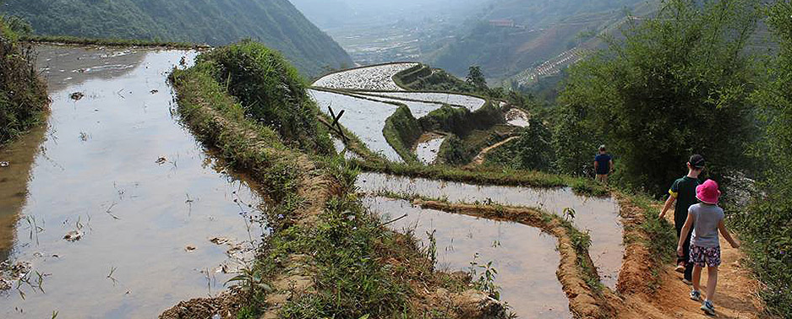

Take your family beyond the resort
.
“Enrich your family holiday with an authentic and
hands-on tailored travel experience.”
Shop for dinner at the market, visit the local village or school, engage with the local community and learn more about the culture of the country you’re visiting. It’s a great way to have
fun, build confidence and instil a love of travel in your children
beyond the resort experience.
_________________________________
Explore Bali / Borneo / Nepal / Vietnam / Cambodia / Fiji and more
Call me to create a unique holiday for your family, full of fun and
learning through travel at the destination of your choice.
To find out more call:
Michelle your personal
travel manager
M: 0466 308 770
P: 1300 763 591
E: michelle.desmarchelier@travelmanagers.com.au
facebook.com/MichelleDesmarchelier
travelmanagers.com.au/MichelleDesmarchelier
Part of the House of Travel Group ACN: 113 085 626 Member: IATA, AFTA, CLIA

